Slide 1
The Joys of JavaScript
Lesson 3.1
Notes:
6:30

Slide 2
Admin Items
Notes:
630

Slide 3
Homework #2: Questions?
Media Queries and Viewport
Bootstrap CSS
Take existing portfolio and apply media queries and viewport to make it mobile-responsive.
Use Bootstrap CSS to re-create the portfolio you built in HW1. Your solution should minimize the use of media queries.
It also needs to be deployed on GitHub Pages and have a nice README.md
Notes:
630-32
Let bootstrap do as much work for you as you can

Slide 4

Algorithms
We now have an “algorithms” directory
These are interview-styled questions
Try these outside of class or if you have time after a pre-class drill
Notes:
632-33

Slide 5
Today’s Class
Notes:
633-

Slide 6

Class Objectives
In today’s class, we will introduce:
JavaScript Definitions
JavaScript Basics:
Variables
Logging, alerting, prompting
Arrays
If/else statements
Notes:
633-35

Slide 7
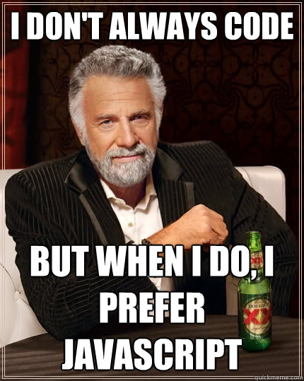
JavaTime for JavaScript!
Notes:
635-36
shutterstock_795217711

Slide 8
How to Learn JavaScript
Notes:
636-36

Slide 9


Your Brain on JavaScript
Notes:
636-38
Learning JavaScript will require having a lot of "little pieces" of code in your mind floating around. The key is in knowing how these pieces fit together to build useful things.
shutterstock_184763024

Slide 10
Time to Take Notes!
Notes:
638-39
This is a section where you will probably need notes to refer back to

Slide 11
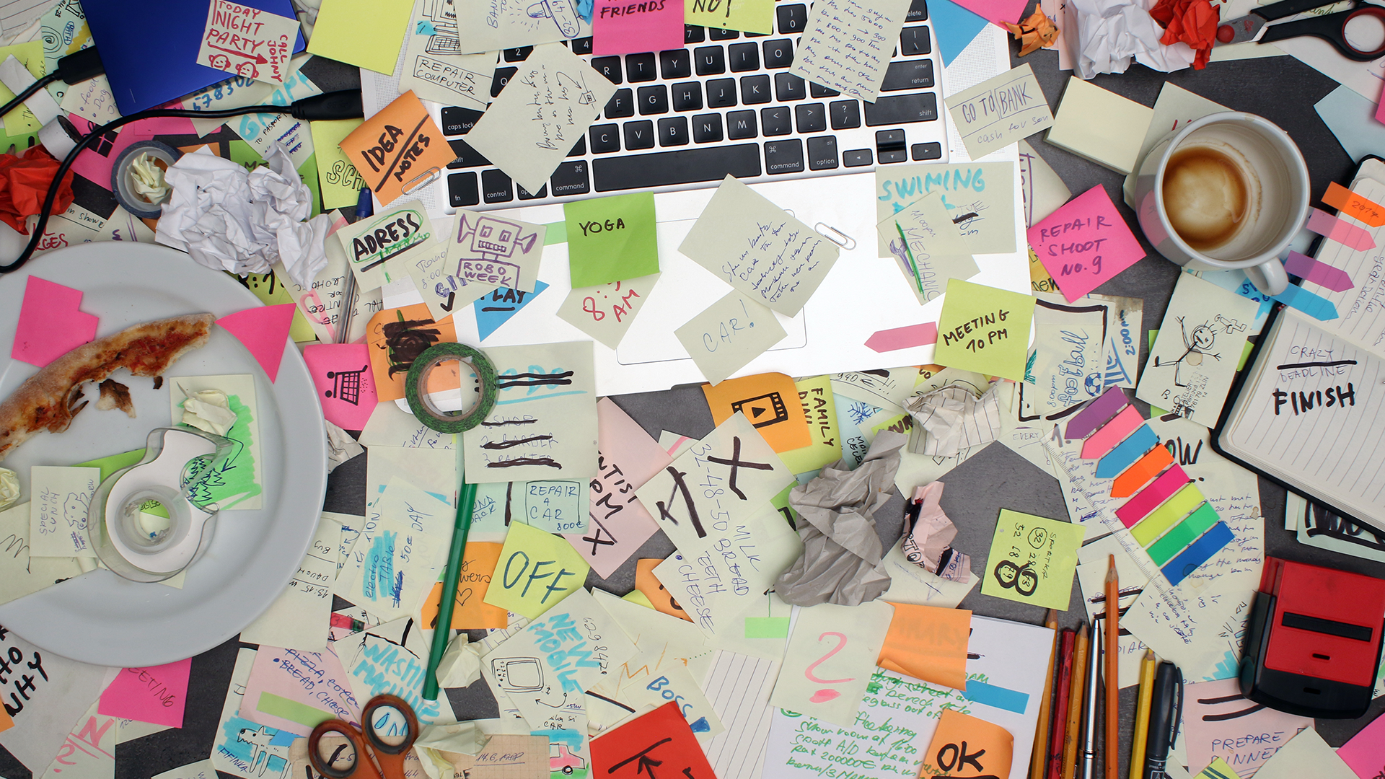
And Stay Organized!
Notes:
639-40
I’ve noticed that many people don’t have clearly organized directory structures.
As things get more complex it’s important to make sure things are organized
It’s easy to get lost otherwise – as you may have noticed
Don’t create things in the GitLab repo
shutterstock_575384821

Slide 12
Learning JavaScript
Follow these general tips:
Review classwork immediately.
Redo class activities at home.
Come to office hours and keep asking questions.
Do not fear—you will get this!
Notes:
640-42
You need to understand every activity we do
If you are stuck – ask questions
I will just redo the activity if that’s what it takes
Stay after if you want more help on an activity
The HW is a superset of all the things from the activities. You cannot do it without understanding the activites.
Hands-on experience is better than just reading

Slide 13
Partner Activity: 01-CodeDissection
A big part of being a developer is learning on the fly!
Notes:
642-49 (7 minutes)

Slide 14
Partner Activity: 01-CodeDissection
01
Open 01-CodeDissection/js-dissect.html
02
Open it in Chrome and observe what happens.
03
With a partner, try to explain how the code connects to the events that happen on the page.
Notes:
642-49 (7 minutes)
We haven’t learned JavaScript but a big part of the job is learning on the fly.
How much of this can you understand on your own?

Slide 15
What Is JavaScript?
Notes:
649-50

Slide 16


JavaScript Definition
JavaScript is one of the three fundamental programming languages of the modern web (the others are HTML and CSS).
HTML | CSS | JavaScript
Used to write content. | Used to format content. | Used to create dynamic web applications that take in user inputs, change what’s displayed to users, animate elements, and much more.
Notes:
649-51
HTML – 3%
CSS – 4%
JavaScript – 10%
Compiled to JavaScript – 83%
Most HTML/CSS is abstracted and basically included as part of our JavaScript

Slide 17
Variables
Notes:
651-51

Slide 18
Variables
The nouns of programming
Numbers, strings, Booleans, etc.
Made up of a name and a value
var name = ‘Fluffy’; var napCount = 7; var isSleeping = true;
Notes:
651-53

Slide 19
Variable Basics: Syntax
Var keyword | Variable name | Assignment | Value | Termination
var | name | = | ‘Fluffy’ | ;
Notes:
653-55

Slide 20
Variable Basics: Syntax
Var Keyword | Variable name | Assignment | Value | Termination
var | name | = | ‘Fluffy’ | ;
 |  |  | Be sure to notice the quotes (‘), which convey that Fluffy is a string.
Notes:
655-56

Slide 21
Variables
Notes:
656-706

Slide 22
Activity: 03-PizzaVariables
In this activity, you will fill in the missing JavaScript code to create variables.
Notes:
656-706
10 minutes
706-711 review

Slide 23
Activity: Variables
01
Using the instructions in the file sent to you, fill in the missing JavaScript code to create variables.
02
When you are done, open the file in Chrome and check the output.
03
If you successfully complete the activity, you will see a series of pop-up windows with text inside.
Finally, look at the rest of the code and try to figure out why the text displayed the way it did.
04
Notes:
656-706
10 minutes
706-711 review

Slide 24
Notes:
656-706
10 minutes
706-711 review

Slide 25
Console Log

Slide 26
Console Log
Notes:
711-16
console.log is an example of a function
This code lives in the JavaScript engine
Kind of like bootstrap gives us pre-built stuff, functions do that in languages
Make certain to show students how the console.log statement can be used to display text, variables, or a combination of the two.

Slide 27
Console.log
console.log is a quick expression that prints content to the debugger—very useful during development and debugging!
var quick = ‘Fox’; var slow = ‘Turtle’; var numbers = 121; // The console.log() method is used to display data in the the browser’s console. // We can log strings, variables, and even equations. console.log(‘Teacher’); console.log(quick); console.log(slow); console.log(numbers + 15);
Notes:
716-18

Slide 28
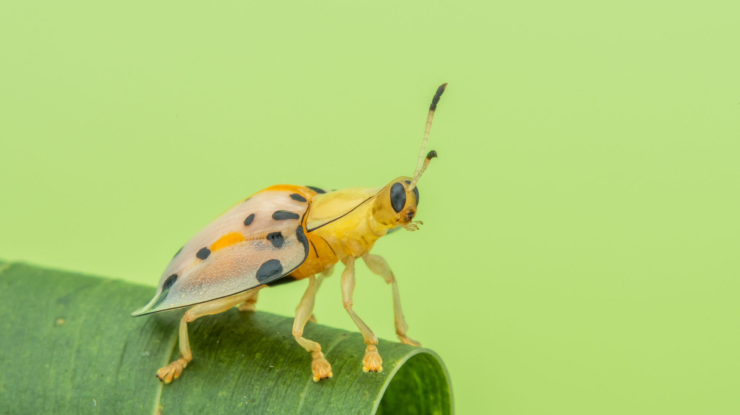
How do you comfort a JavaScript bug?
Notes:
shutterstock_1242632743

Slide 29
How do you comfort a JavaScript bug?
You "console" it!
Notes:
shutterstock_1242632743

Slide 30
Activity: Console Log
05-PizzaConsole
Notes:
718-25 7 minutes

Slide 31
Activity: Console Log (05-PizzaConsole)
01
Using the file sent to you as a guide, modify the code so that is uses console.log instead of alerts to display messages.
Then open the file in the browser and open up Chrome Developer Tools -> Console to confirm that the changes worked.
02
With a partner, discuss the difference between console.log and alert.
03
alert(’Welcome: ‘ + name); alert(‘Pizzas cost $5 each’); alert(‘Your total is: $’ + totalCost); alert(‘Still Hungry: ‘ + isHungry);
Notes:
718-25 7 minutes
Suggested Time: 7 minutes
725-30 5 minutes
review
Why would you use one over the other?

Slide 32
Notes:
15 minutes

Slide 33
Alerts, Prompts, Confirms
Notes:
BREAK
15 minutes
730-45

Slide 34
Alerts, Prompts, Confirms
Notes:
745-50 (5 min)
Explain that functions that "give you something back" are said to returnsomething.
Explain that prompt and confirm return whatever the user enters in the text prompt.

Slide 35
Alerts, Prompts, Confirms
Alerts, prompts, and confirms create a popup in the browser when run.
These are also useful for development and debugging.
// Alert alert(‘We definitely rock!’); // Confirm var doYouRock = confirm(‘The question is, do “you” rock?’); // Prompt var howMuchRock = prompt(‘How much do you rock?’);
This page says:
We definitely rock!
OK
This page says:
The question is, do “you” rock?
Prevent this page from creating additional dialogs.
OK
Cancel
This page says:
How much do you rock?
Prevent this page from creating additional dialogs.
OK
Cancel
Notes:
750-53

Slide 36
Activity: Alerts
07-PromptSushi
Notes:
753-808 (15 min)

Slide 37
Activity: Alerts (07-PromptSushi)
Write JavaScript code that does the following:
01
Using a confirm, ask the user “Do you like _____?” and store their response in a variable.
Using a prompt, ask the user: “What kind of _____ do you like?” and store their response in a variable.
02
alert both variables to the screen.
03
Notes:
753-808 (15 min)
Suggested Time: 15 minutes
108

Slide 38
Notes:
808-813
review

Slide 39
If/Else Statements
Notes:
813-23
Talk about what this control flow means

Slide 40
Conditionals
Notes:
813-23
Talk about what this control flow means
// Here we create our prompt and confirm variables which will store user input.
var confirmSushi = confirm("Do you like sushi?");
var confirmGingerTea = confirm("Do you like Ginger Tea?");
var sushiType = prompt("What kind of sushi do you like?");
// If the user likes sushi (confirmSushi === true), we run the following block of code.
if (confirmSushi) {
alert("You like " + sushiType + "!");
}
// If the user likes ginger tea (confirmGingerTea === true), we run the following block of code.
else if (confirmGingerTea) {
alert("You like ginger tea!!");
}
// If neither of the previous condition were true, we run the following block of code.
else {
alert("You don't like sushi or ginger tea.");
}

Slide 41
If/Else Statements Are Critical
Each statement is composed of an if, else-if, or else (keyword), a condition, and the resulting code in curly brackets { }.
// If the user likes sushi (confirmSushi === true), we run the following block of code. if (confirmSushi) { alert("You like " + sushiType + "!"); } // If the user likes ginger tea (confirmGingerTea === true), we run the following block of code. else if (confirmGingerTea) { alert("You like ginger tea!!"); } // If neither of the previous condition were true, we run the following block of code. else { alert("You don’t like sushi or ginger tea.");
Notes:
823-25

Slide 42
Partner Activity: If/Else Part 1
With a partner you will create a website (from scratch) that asks users if they eat steak. (09-ConditionalActivity)
Notes:
825-40
15 minutes

Slide 43

Partner Activity: If/Else Part 1 (09-ConditionalActivity)
01
With a partner, create a website (from scratch) that asks users if they eat steak.
If they respond with yes, alert the following to the page: “Here’s a Steak Sandwich!”.
02
If they respond with no alert the following to the page: “Here’s a Tofu Stir-Fry!”.
03
Bonus: Ask what the user’s birth year is. If they are under 21, alert the following: “No sake for you!”
Notes:
825-40
Suggested Time: 15 minutes
Add more to birth year
If > 199X

Slide 44
Notes:
840-50 (10 min)
TAs: Slack out the video review for this activity which can be found here.
https://www.youtube.com/watch?v=rlhhRVO5EOg

Slide 45
Activity: If/Else Part 2 (10-ConditionalActivity2)
As a class, we will go through and predict what the result of a conditional statement will be.
Notes:
850-9
10 minutes

Slide 46
Activity: If/Else Part 2
Class activity (everyone together)
Open 10-ConditionalActivity2/conditional-demo-2.html
As a class, go through and predict what the result of each conditional statement will be (i.e., will the “if” or the “else” be triggered).
We’ll check answers as we go
Notes:
850-9
Suggested Time: 10 minutes

Slide 47
Arrays
Notes:
9

Slide 48
The Zoo Pen
Array Name: zooAnimals
Zebra | Rhino | Giraffe | Owl
Index 0 | Index 1 | Index 2 | Index 3
Notes:
9-03
I have a collection of markers

Slide 49
The Zoo Pen: Coded
Array Name: zooAnimals
Coded in JavaScript using an Array
Coded in JavaScript using an array:
Zebra | Rhino | Giraffe | Owl
Index 0 | Index 1 | Index 2 | Index 3
// Our array of zoo animals. var zooAnimals = [‘Zebra’, ‘Rhino’, ‘Giraffe’, ‘Owl’];
Notes:
9-903

Slide 50
Arrays
Arrays are a type of variable that are collections.
These collections can be made up of strings, numbers, Booleans, other arrays, objects … anything.
Each element of the array is marked by an index. Indexes always start with 0.
var nickCharacters = [‘Tommy’, ‘Doug’, ‘Oblina’]; var diceNumbers = [1, 2, 3, 4, 5, 6,]; var mixedArray = [‘Zoo’, 12, ‘Carrot’, 3];
Notes:
903-05

Slide 51
Arrays: Indices
To recover the value at any specific index, include the name of the array with a square bracket [ ] and inside the bracket is the element’s index.
You can easily grab the number of elements in the array using the method array.length.
// Our array of zoo animals. var zooAnimals = [‘Zebra’, ‘Rhino’, ‘Giraffe’, ‘Owl’]; // Prints 4 to the console because there are 4 items in our zooAnimals array. console.log(zooAnimals.length); // Prints Rhino to the console. Remember, the first item in an array has an index position of 0! console.log(zooAnimals[1]); // Prints undefined...because the last index ("Owl") is 3. console.log(zooAnimals[4]);
Notes:
905-7

Slide 52
Arrays
Notes:
907-12 (5 min)
Open the file arrays-demo.html in 11-ArraysDemo. Show students how this example matches the one in the slides.
Point out how the index system works (i.e. starts at 0 and ends one before the length).
Code it myself
// Our array of zoo animals.
var zooAnimals = ['Zebra', 'Rhino', 'Giraffe', 'Owl'];
// Prints 4 to the console because there are 4 items in our zooAnimals array.
console.log(zooAnimals.length);
// Prints Rhino to the console. Remember, the first item in an array has an index position of 0!
console.log(zooAnimals[1]);
// Prints undefined... because the last index ("Owl") is 3.
console.log(zooAnimals[4]);

Slide 53
Partner Activity: Code Dissection (12-ArraysActivity)
With a partner, take a few moments to look over the following code (sent via Slack).
Above each console.log(), write a comment predicting what you think the output will be.
Notes:
912-19
Suggested Time: 7 minutes
919-22
review

Slide 54
Questions, Comments, Concerns?
Notes:
922-27

Slide 55
Homework #3
Notes:
927-30
Demo it

Slide 56
Challenge: Favorite Band Array
In this challenge, you will create an array of your favorite bands.
Notes:
930-45
15 minutes

Slide 57
Challenge: Favorite Band Array (13-Bands)
Create a website that accomplishes the following:
01
Create an array of your favorite bands.
02
With a prompt, ask the user’s favorite band.
03
If it’s one of your favorites, alert: “YEAH, I LOVE THEM!”
04
If it’s not, alert: “Nah. They’re pretty lame.”
Hint: You will need to research how to use .indexOf()
Hint: You will also need to research how to use .toLowerCase()
Notes:
930-45
Suggested Time: 15 minutes

Slide 58
Challenge: Code Dissection (Re-examined)
Re-examine the file sent to you at the start of class. See if you can better understand how it works after having completed today’s class.
Notes:
945-57
12 minutes
For the second challenge, students should go back to the first example shown in class (the js-dissect.html file in 01-CodeDissection. Have them re-examine the code to see if they understand it better.

